Slide 1
FIVCO Area Development District
By: Lance Hanshaw

Slide 2
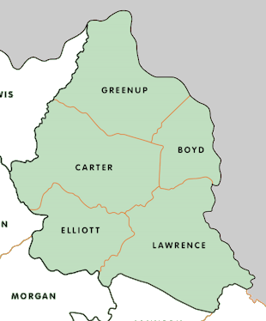
Introduction
What is FIVCO?
FIVCO stands for FIVe COunty Area Development District.
Serves Boyd, Carter, Elliott, Greenup, and Lawrence Counties in Kentucky.
Mission
To enhance regional economic development, improve infrastructure, and elevate the quality of life for residents.

Slide 3
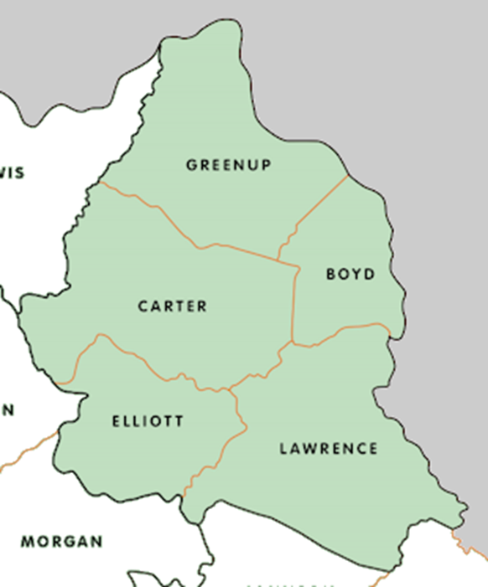
Planning & Transportation Services
Planning: Boyd, Carter, Elliott, Greenup, & Lawrence
Transportation: Carter, Elliott, & Lawrence

Slide 4
FY25 RTC Goals
Overall Goal:
Promote the efficient, economical, and safe movement of people, goods, and services through out the FIVCO Region by linking population centers with accessible transportation facilities that will enhance economic development and improve the quality of life.

Slide 5
…continued
Improve access (highway, rail, waterway, pedestrian, bicycle, transit, intermodal)
Encourage economic development opportunities and tourism.
Improve safety of the region’s transportation system.
Utilize the transportation system to enhance quality of life.
Improve intermodal access.
Expand aviation services.
Enhance public transportation.
Improve organizational performance.
Strengthen relationships with customers and stakeholders.

Slide 6
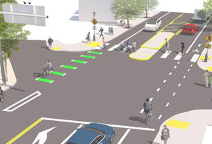
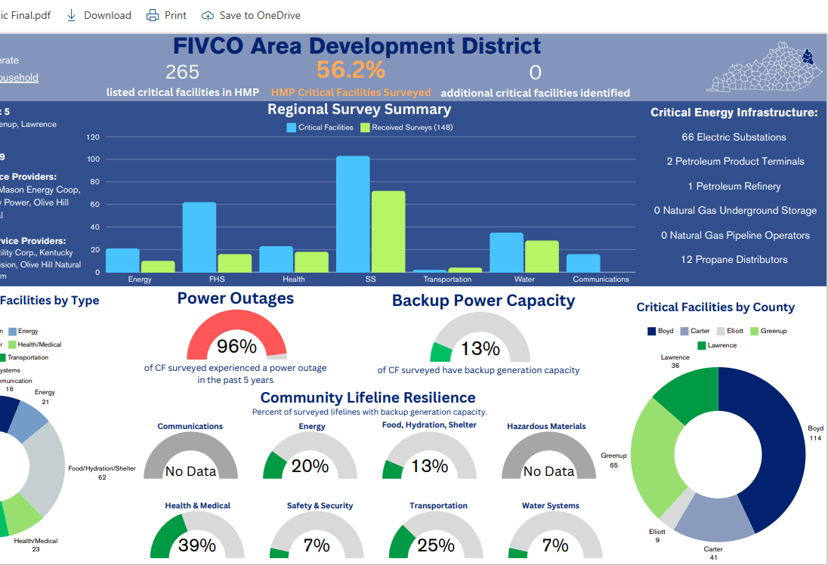
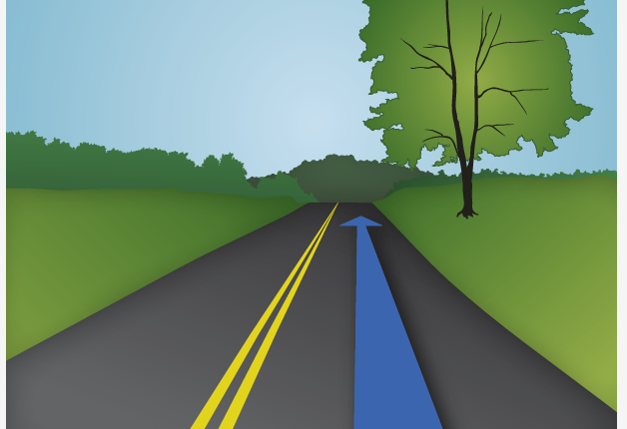
Current Projects & Initiatives
Notes:
Local Roads Updates: Coordinating with local governments to prioritize and plan improvements for roads within the district. This often involves pavement resurfacing, drainage improvements, and addressing safety concerns.
Transportation Planning: FIVCO plays a significant role in regional transportation planning, including collaborating with state and federal agencies to develop long-range transportation plans. These plans focus on maintaining and upgrading key transportation routes and enhancing connectivity across the region.
Technical Assistance: Providing support and technical expertise to local governments in navigating transportation-related grant applications and funding opportunities, including the Transportation Alternatives Program (TAP) and other state and federal funding sources.
Hazard Mitigation Planning: Integrating transportation concerns with hazard mitigation strategies to ensure infrastructure resilience in case of disasters like flooding or severe weather, which are common in the region.
GIS Administrative Services: Using Geographic Information Systems (GIS) to map, analyze, and improve transportation networks, helping to optimize project planning and execution.
BEAD and BRIC Programs: Through initiatives like Broadband Equity, Access, and Deployment (BEAD) and the Building Resilient Infrastructure and Communities (BRIC) program, FIVCO incorporates transportation elements in broader community resilience and infrastructure development projects.
These projects aim to strengthen transportation infrastructure and ensure that roads and transit systems in the region meet the needs of the population.

Slide 7
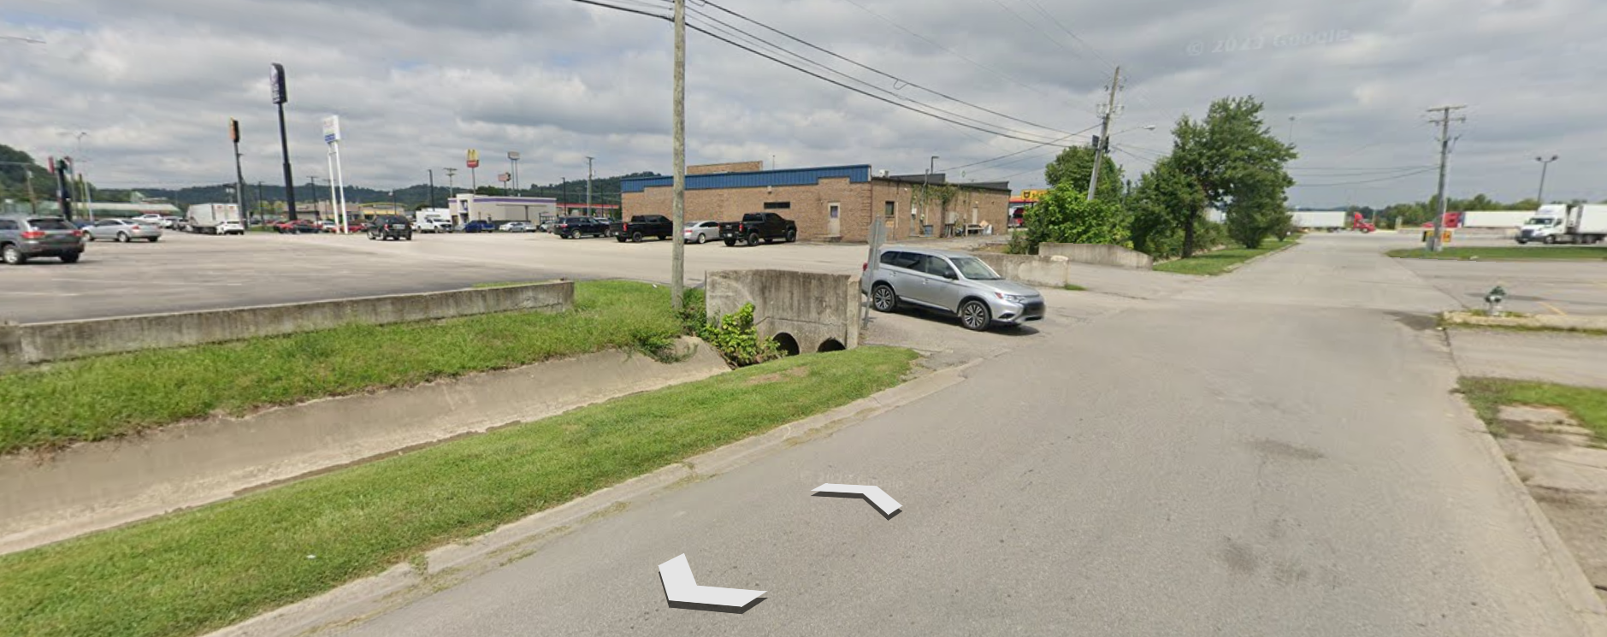
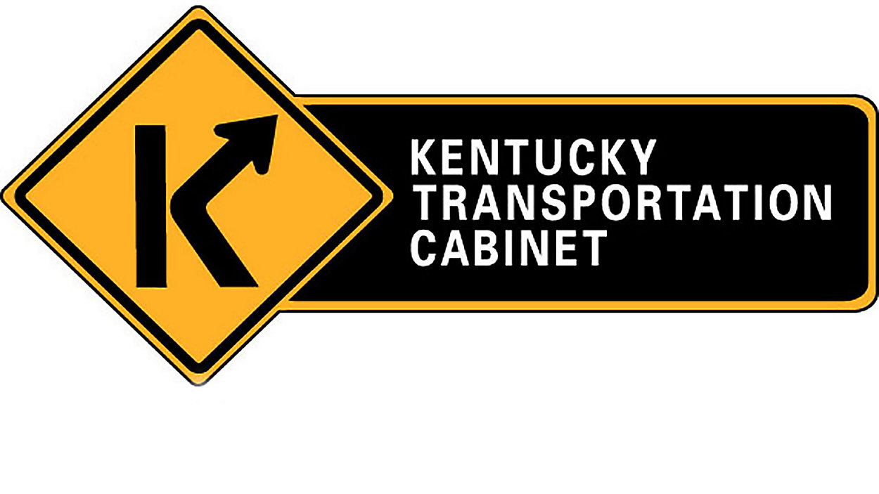
Future Projects & Initiatives
Transportation Alternative Program (TAP)
Rupert Lane Grayson, KY
Notes:
Safe Streets for All is a federal initiative to reduce roadway fatalities by improving safety for drivers, pedestrians, and cyclists through local planning and infrastructure upgrades. It promotes equitable, accessible, and safer transportation for everyone.
The KY SHIFT program is a data-driven system for prioritizing transportation projects in Kentucky, focusing on safety, congestion, economic impact, and regional needs to ensure efficient and transparent funding allocation.
Rupert Lane – project in Grayson, KY to fix flooding issues on roadway and residentials.
Kentucky's TAP program provides federal funding for projects that improve pedestrian and bike paths, safe routes to schools, and enhance non-motorized transportation.

Slide 8
Questions?
For more information:
FIVCO Area Development District
32 FIVCO Court
Grayson, KY 41143
606-929-1366
lance@fivco.org
Notes:
Feel free to stop by our office if you’re in the area, give us a call at 606-929-1366, or send me an email.
Also, you’re more than welcome to attend our monthly board meetings that happens on the third Monday of the month at 12:30.

